Slide 1
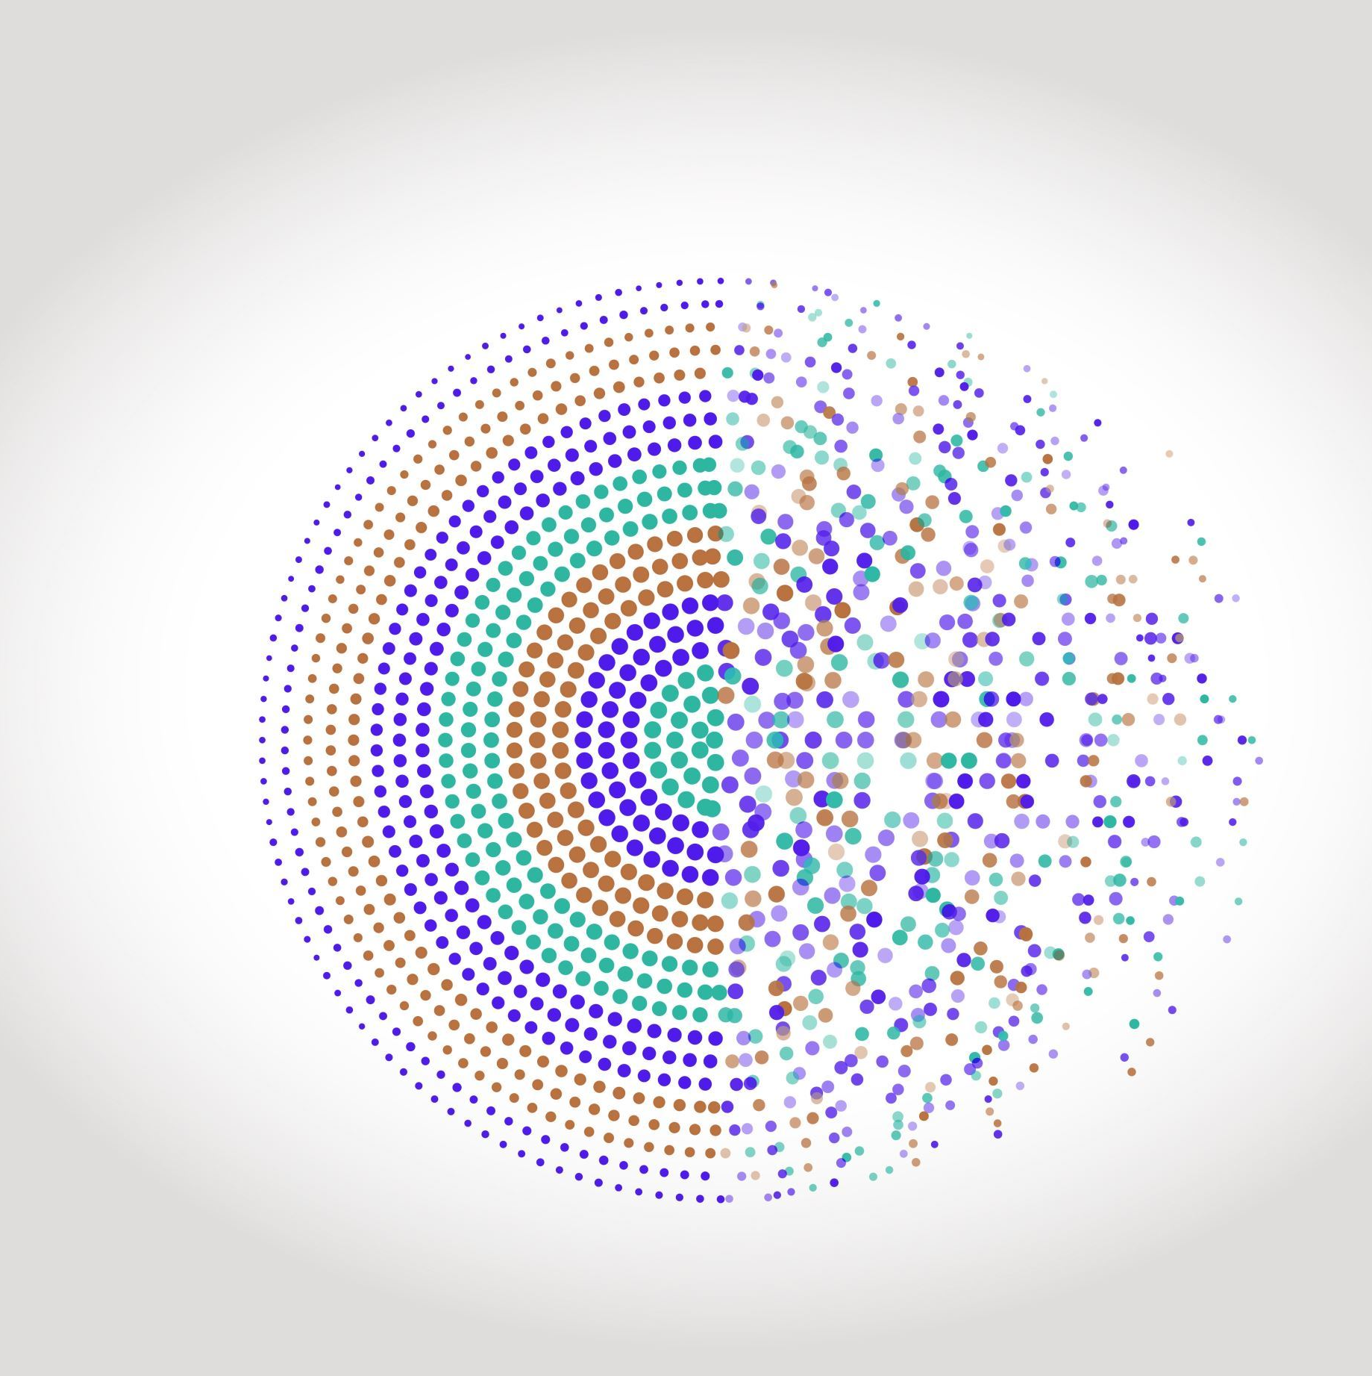
LGBM
REGRESSION

Slide 2
LIGHT GRADIENT BOOSTED MACHINE (LGBM)
Light Gradient Boosted Machine, or LightGBM for short, is an open-source implementation of gradient boosting designed to be efficient and perhaps more effective than other implementations.
It uses the below techniques to work quickly and effectively,
Gradient-based One Side Sampling (GOSS) to speed up training by focusing
on the most important data points.
Exclusive Feature Bundling (EFB) groups related features together,
making it easier for the model to learn patterns.

Slide 3
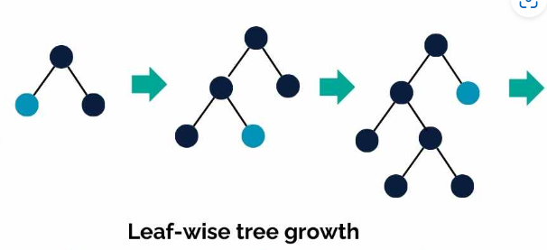
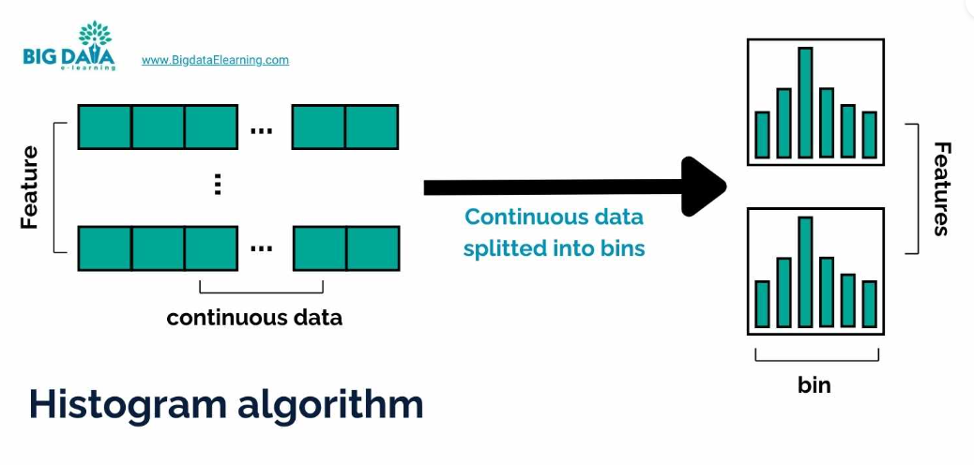
MECHANISM
In LightGBM, histogram-based algorithms split continuous data into bins (like creating histograms).
This reduces the number of comparisons needed during splits, speeding up computations while maintaining accuracy.
LGBM uses leaf-wise growth strategy, which targets the most valuable branches first leading to deeper and more optimized trees, with a focus on improving model accuracy.

Slide 4
ADVANTAGES
Faster training speed and higher efficiency
Lower memory usage
Better accuracy
Support of parallel and GPU learning
Capable of handling large-scale data

